Slide 1
Agile software developer

Slide 2
Foundations of Agile and Agile frameworks

Slide 3
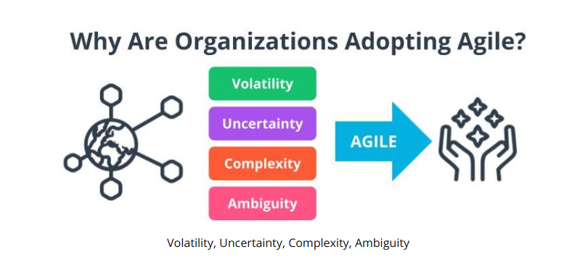
Faster time to market
Early ROI
Feedback from Real Customers

Slide 4
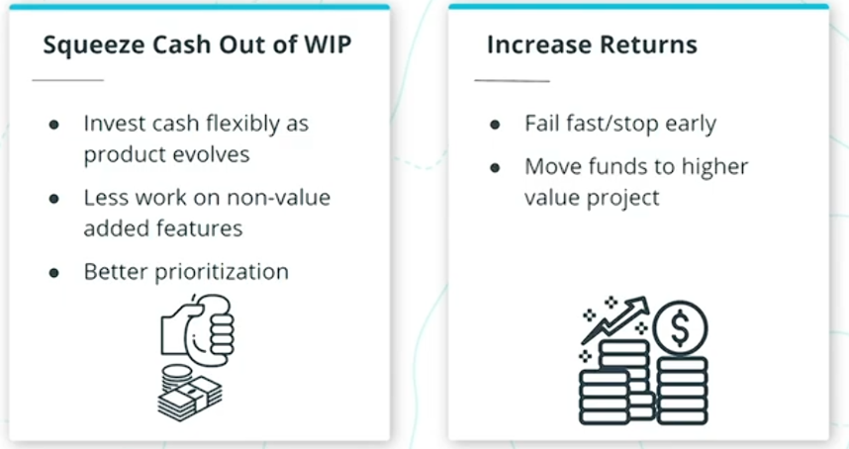

Slide 5
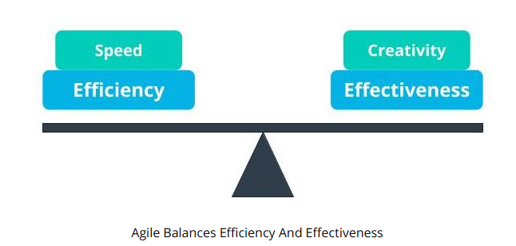
Organizations that go through Agile transformation have also benefited from:
Build the right products
Early risk reduction
Built-in quality
Culture and morale

Slide 6
New Terms
Muda: Lean principles refer to the Japanese term Muda as waste; Agile teams focus on the removal of non-value adding tasks that are seen as Muda
Product Owner: A business proxy or representative of the business users who is the Voice of the Customer (VOC)
Return on Investment (ROI): Return on investment (ROI) is calculated as the ratio between net profit and cost of investment over a defined period of time
Uncertainty: The extent to which an organization can confidently predict or forecast the future; more uncertainty makes it harder to predict
Voice of the Customer: A term used to articulate the steps to capture customer's needs
Volatility: Volatility is when there are unexpected or unstable possibilities that may influence the work being done
VUCA: Volatility, Uncertainty, Complexity, Ambiguity
WIP (Work in Progress): The work that has been started but not yet completed

Slide 7
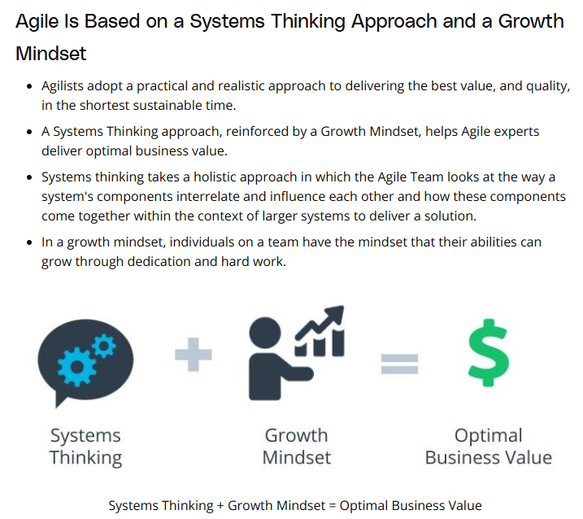

Slide 8
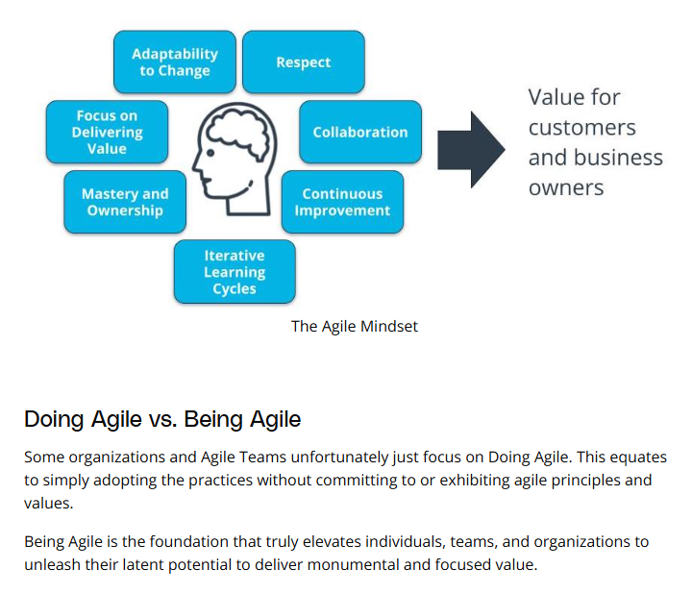

Slide 9
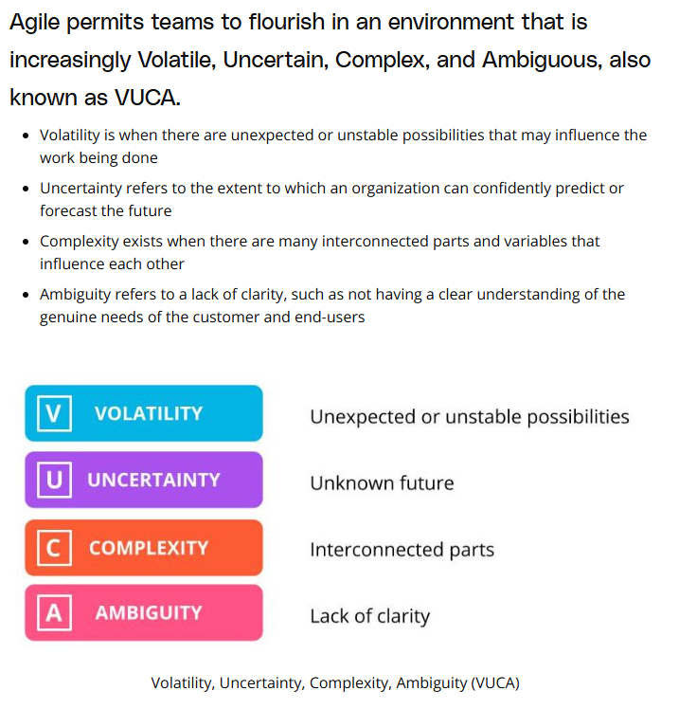

Slide 10
New Terms
Agile Mindset: The set of attitudes supporting an agile working environment
Being Agile: When an Agile team lives & breathes Agile principles and values through Agile practices consistently every day
Business Agility: The ability of an organization to adapt quickly to market changes, respond rapidly and flexibly to customer demands that make business sense, as well as adapt and lead change in a productive and cost-effective manner with no compromise to quality
Doing Agile: When an Agile team adopting the practices without committing to or exhibiting Agile principles and values
Additional Resources
Gil Broza, The Agile Mind-Set: Making Agile Processes Work, 3P Vantage Media, 2015. This book clearly articulates how the missing piece in successfully transforming organizations to Agile is the Agile Mindset.

Slide 11
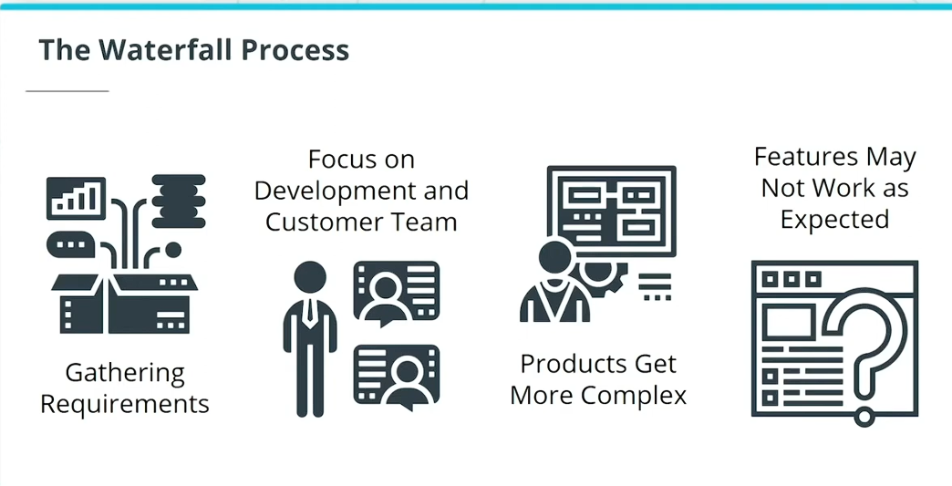

Slide 12
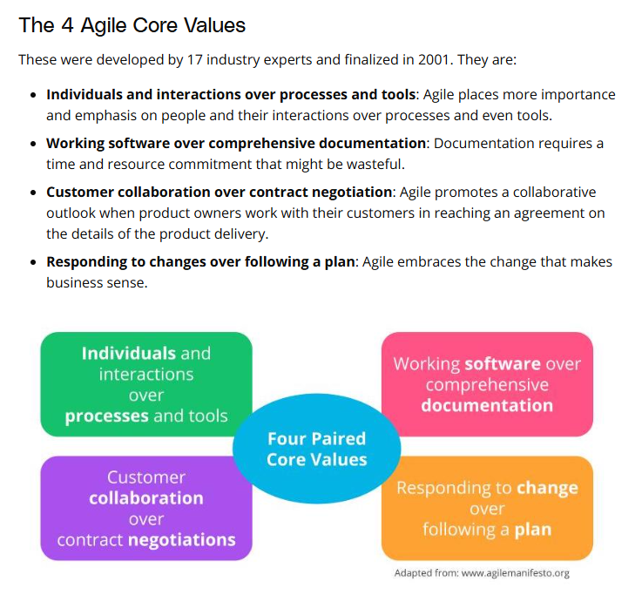

Slide 13
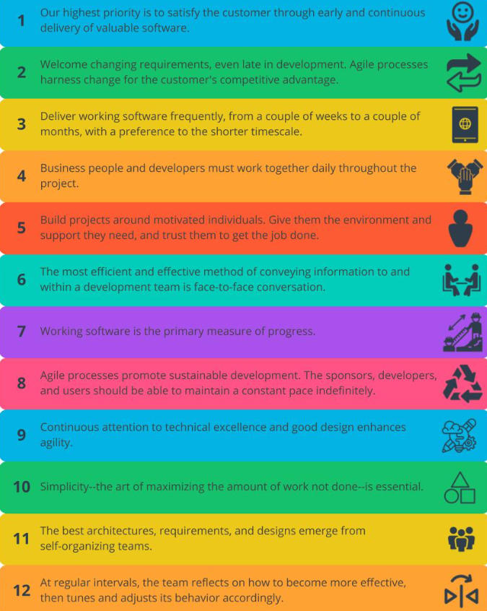
12 Agile principles
Agile Sprint Plan Template - ProjectManager

Slide 14
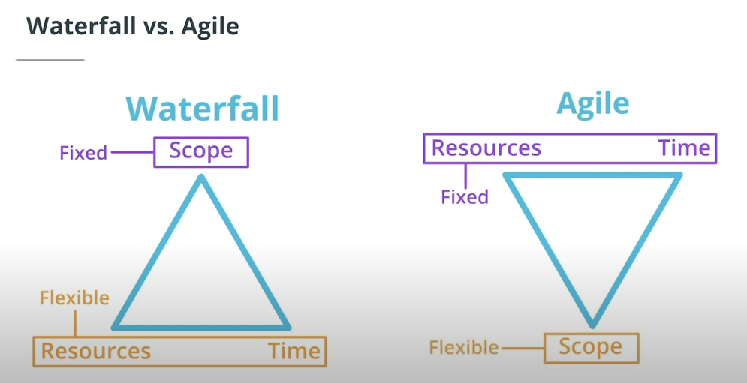

Slide 15
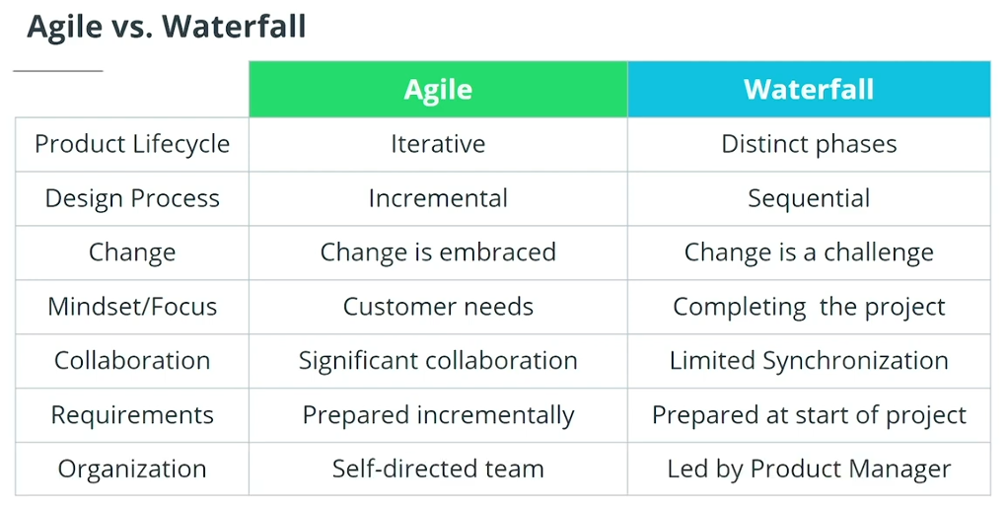

Slide 16
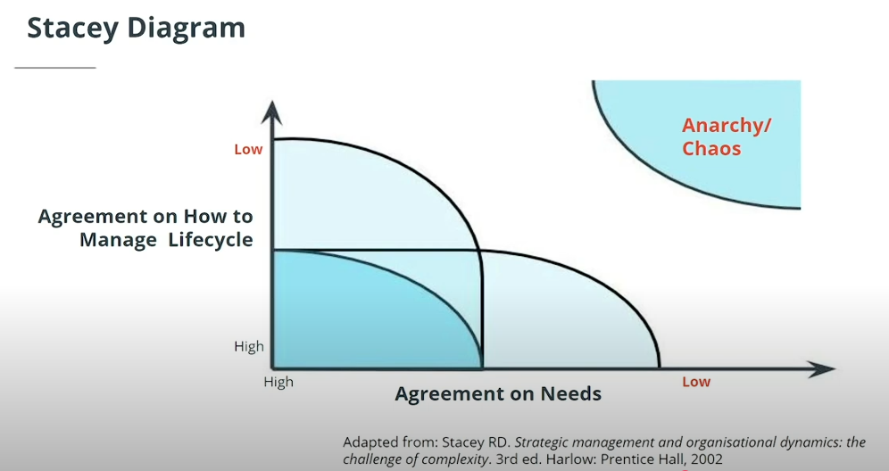

Slide 17
Conditions Where Agile May Not Be Helpful:
Lack of agreement in terms of requirements and process
No vision and no clear roadmap
Near certainty on requirements and process upfront
Conditions Where Agile Works Best:
An environment of complexity and some uncertainty where an adaptive approach is needed
With complicated requirements that need iterative cycles to understand the needs of end-users

Slide 18
Common Misconceptions of Agile
Here are 5 of the more common Agile misconceptions that should be avoided keeping the Agile Mindset in focus:
Scheduling Agile ceremonies makes a team Agile - Holding ceremonies for the sake of holding ceremonies does not deliver benefits. Ceremonies must adhere to the core principles of Agile.
The Facilitator role is just like a traditional Project Manager - The Facilitator role is different from the Project Manager role. A Facilitator should be a Servant Leader who assists with whatever the team needs to forward.
Large teams are okay - Agile recommends small cross-functional teams that allow the team to be nimble and powerful.
The product backlog can be managed like a traditional requirements document - The backlog should not be a process-driven document. It should focus on customer value and strategic objectives.
Documentation and audit trails for compliance are not important in Agile - Agile does not mean no documentation -- it just removes low-value documents and documents what is valuable to maintain and sustain the product.

Slide 19
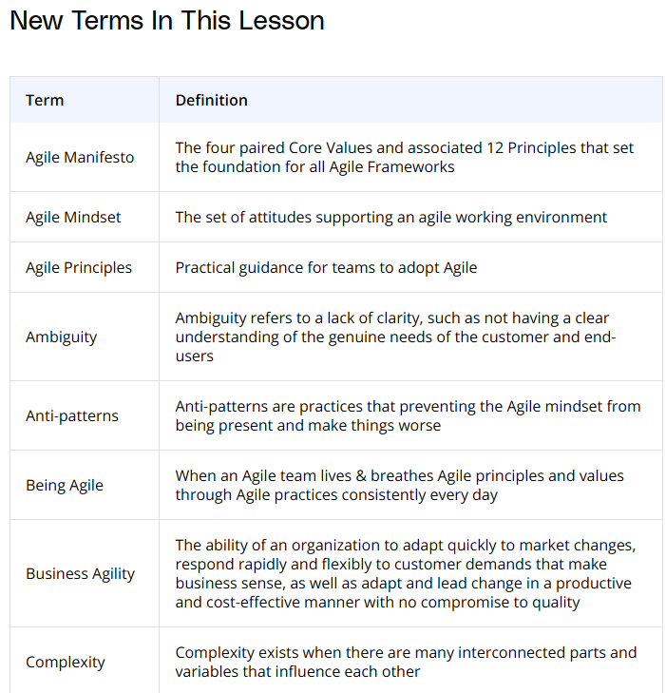
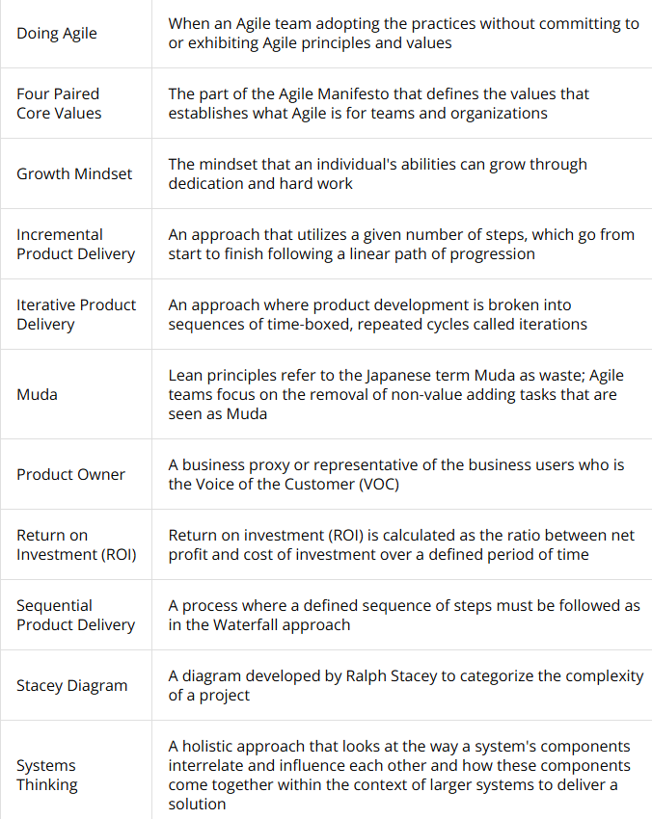

Slide 20
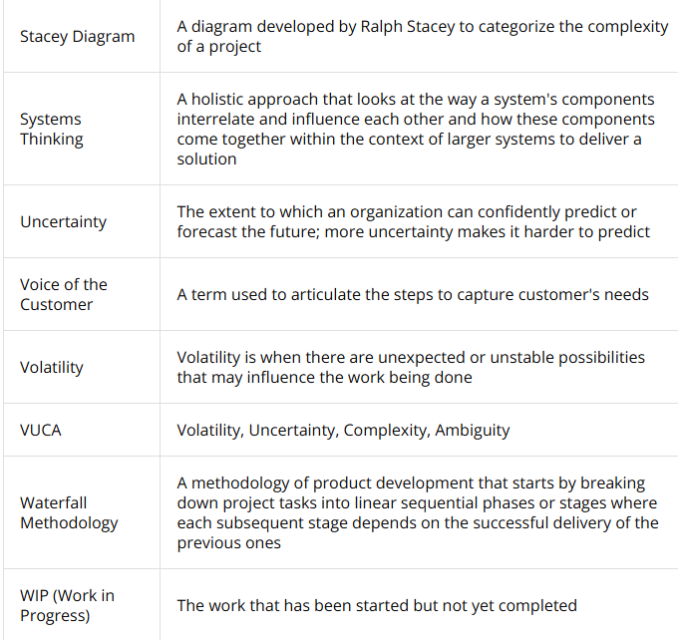

Slide 21
1.2. Build and evolve Agile teams

Slide 22
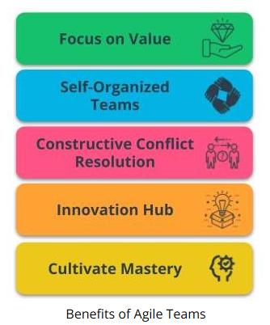
Why Do Agile Teams Matter?
Focus on Value - Agile is driven by the goal of delivering maximum business value that is aligned with the organization’s vision.
Self-Organized Teams - Agile Teams have the autonomy to make some de-centralized decisions, which allows for shared ownership of the work.
Constructive Conflict Resolution - Conflicts in Agile Teams are constructively resolved because the team is driven by a shared vision.
Innovation Hub - Agile Teams, with diverse and cross-functional skill sets, are an innovation hub that spurs solutions.
Cultivate Mastery - Time is put aside in Agile Teams for learning and growth. This allows Agile Team members to sharpen their skills.

Slide 23
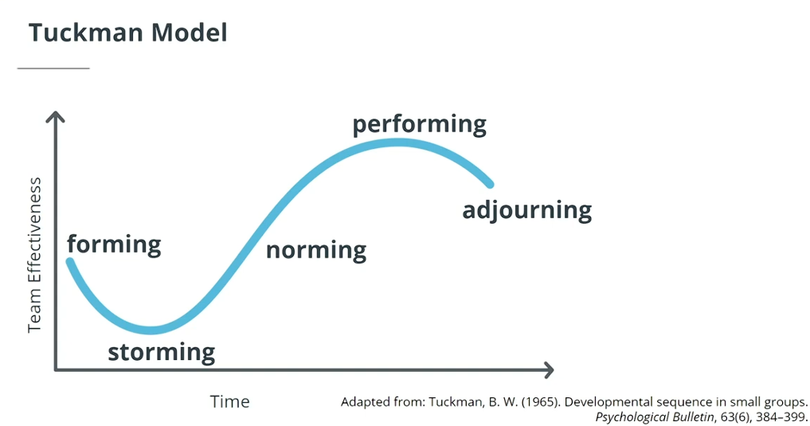
Tuckman Model
The Tuckman Model, which has 5 stages of team development, describes how an Agile team progresses into an awesome Agile squad.
Forming - Agile Team comes together and the Facilitator helps the team form by explaining the ground rules, product vision, and expected outcomes.
Storming - This is where a team’s velocity is impacted because there tends to be some confusion and ambiguity around the work to be done, roles, and other product-related questions.
Norming - Agile Team members develop a sense of trust and camaraderie. There’s a healthy rapport and each team member starts to look for the collective objectives of the team’s long-term success.
Performing - Once an Agile Team has successfully worked together over a few iterations they should be in a state where they have gelled together and developed a strong cross-functional work style.
Adjourning - If the business leaders realize that a product is not delivering value or is no longer needed in the market, the existing Agile Team members can be re-allocated to other more valuable work in the organization.

Slide 24
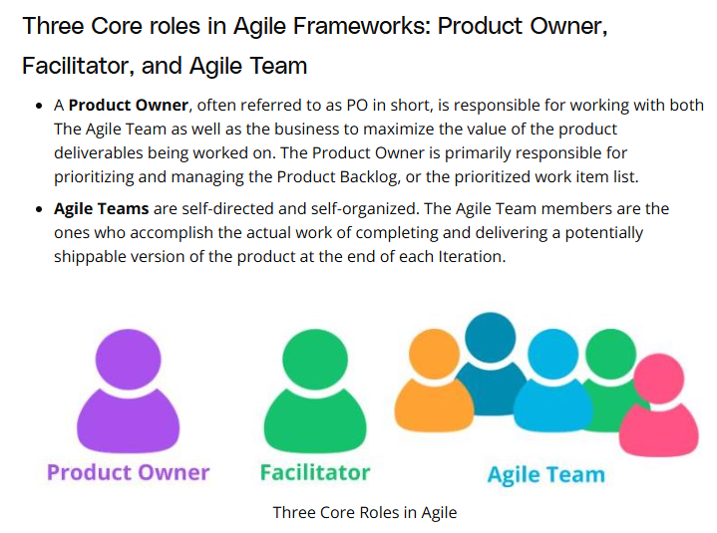
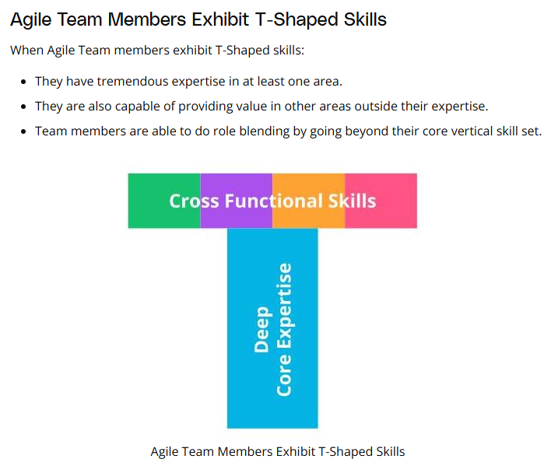

Slide 25
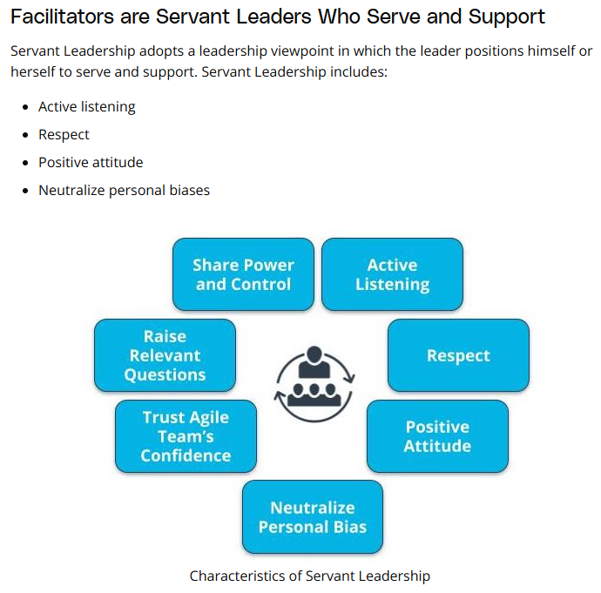

Slide 26
New Terms
Facilitator: The person who ensures that the Agile Team moves along at an acceptable pace towards the business objective and removes any blockages or impediments that may be slowing the team
Self-Directed: Team members are empowered to decide among themselves who does what and how it is to be accomplished in a collaborative manner
T-Shaped Skills: A strong vertical skill combined with the capability and willingness to step into other cross-functional needs
Team Member: The people who accomplish the actual work of completing and delivering a potentially shippable version of the product at the end of each iteration

Slide 27
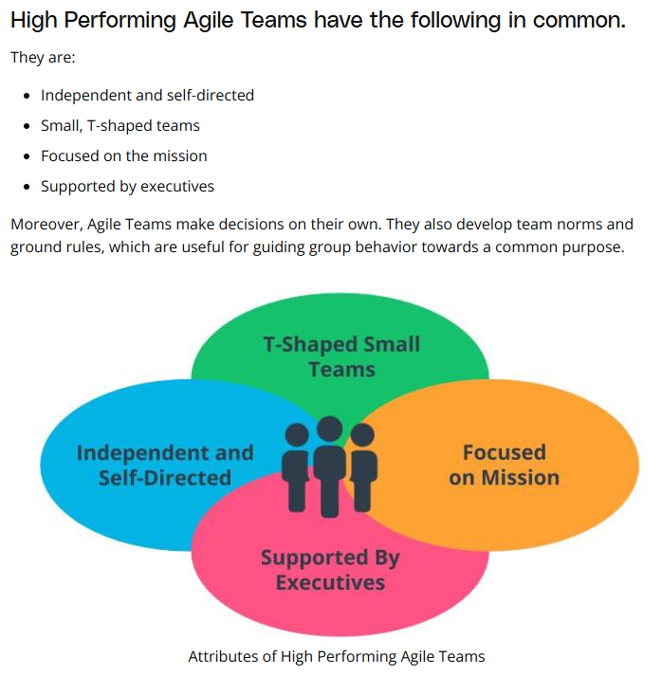

Slide 28
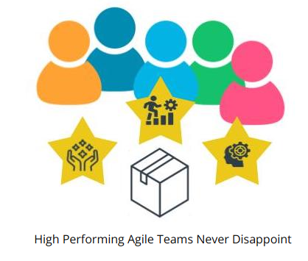
Building a High Performing Agile Team
Let’s look at how we can build a high performing Agile Team:
Inspire the Agile Team.
Build a Cross-functional Diverse Team.
Maintain Focus as Team Evolves.
Encourage Innovation and Free Thinking.
Communicate Clearly.
Work Collaboratively to Solve Problems.
Timebox Meetings.
Recognize and Appreciate.
Include Uncommitted Objectives.
Take Time Out to Connect and Have Fun.
High Performing Agile Teams Never Disappoint
According to the American author Dan Pink, a high performing team is given purpose, an opportunity to develop mastery, as well as autonomy in decisions. Such a high-performing Agile Team never disappoints. Such Agile Teams deliver phenomenal results consistently, regardless of the challenges they encounter. Senior leaders in an organization can turbocharge an Agile Team by enabling them to be self-directed and independent.

Slide 29
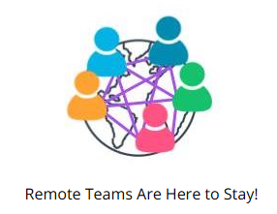
Remote Agile Teams
In an increasingly interconnected global business landscape, High Performing Agile Teams have to identify issues and benefits related to organizing and managing remote Agile Teams. The recent COVID-19 pandemic has genuinely changed the landscape with remote Agile Teams being accepted as a valuable norm.
Working with a remote Agile team successfully requires attention to the following:
Team communication.
Time Zone Differences.
Work From Home Best Practices.
Catch-Ups.
Lack of Team Cohesion.

Slide 30
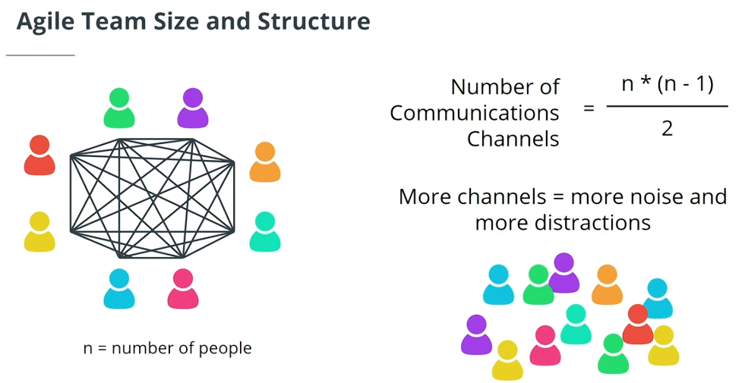
Organizing an Optimal Agile Team and Non-Core Roles

Slide 31
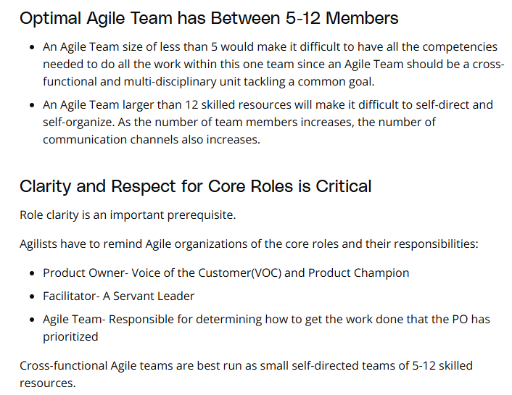

Slide 32
Non-Core Roles
While Non-Core Roles are not defined as mandatory in all Agile Frameworks, they can play a key role in the success of Agile Product Delivery.
Stakeholders - Stakeholders can include Customers, Users, Sponsors, and others who have an interest in the product being worked on, but are not involved in the day-to-day development of the solution results.
Vendors and Strategic Suppliers - Vendors and Strategic Partners provide products and services that are usually not within the core competencies of the organization or Agile Team.
Center of Excellence (CoE) - Many organizations have a Center of Excellence focused on either Project or Product Delivery. A CoE often provides guidance on Governance and Reporting requirements to executives and regulators.
Enterprise Architect - Reviews technical solutions to ensure they align with the overall organization's architecture.
Domain Subject Matter Expert - Provides valuable support to the PO and Business Analyst on domain knowledge.
A successful Agile Team is typically both influenced and supported by several key Non-Core Roles.

Slide 33
Coaching Models
Dreyfus Model of Skill Acquisition
The Dreyfus model presents a simple-to-understand framework for measuring an individual’s progress in any skill they are looking to acquire and gain expertise in. The five developmental stages identified in the Dreyfus Model for Skill Development are:
Novice
Advanced Beginner
Competent
Proficient
Expert
Read more about the Dreyfus Model of skill acquisition: The Five-Stage Model of Adult Skill Acquisition

Slide 34
Shu Ha Ri
Shu Ha Ri has its origins in Japanese Martial Arts. It is presented by experts as a way of thinking when learning a new skill. Alistair Cockburn is credited with introducing it in the Agile world when it comes to acquiring Agile skills for product development. There are three stages in Shu Ha Ri’s knowledge acquisition model:
Shu: Here the Agile team member mimics and follows the teachings of an expert.
Ha: At the Ha stage, team members start to experiment and begin to dig deeper into the theory that is driving the expert’s teachings
Ri: When someone reaches the Ri stage, they have directly experimented and experienced how teaching is beneficial to the Agile team’s maturity. This allows them to get creative and adapt to their unique circumstances and organizational context.
You can read more about Shu Ha Ri here:
Shu Ha Ri: An Agile Adoption Pattern
Becoming agile with ShuHaRi
New Terms
Center of Excellence (COE): A unit comprised of seasoned experts in the organization that provide the Agile team support, best practices, guidance, and perhaps even training on Agile practices
Enterprise Architect (EA): A team member who ensures IT and the business units are aligned

Slide 35
Effective Agile Governance is about Making Decisions
In order to enable effective Agile governance, the following needs to be kept in mind:
Tolerances Are Essential For Agile Governance.
Decentralized Decision Making Empowers The Team.
Agile Governance Delivers Goodwill and Trust.
Agile Promotes Light and Simple Governance.
Strategic and Long-Term Decisions Remain Centralized.
Effective Agile governance ensures decisions are made in a simpler and lighter manner per the Agile Manifesto’s guidance to keep things simple.
Additional Resources
Governing Agile Teams
- This article discusses various facets of what is and what is not considered Agile governance.
Organizing: Centralization and Decentralization
- This article compares the advantages of centralized and decentralized organization and describes the factors for determining the degree of decentralization decision-making.

Slide 36
Agile Governance Body Model
Centralized Decisions
Decisions that are unlikely to alter in the short term at SocialKare.gov; examples could include a significant technology platform selection or organizational structure alignment.
Decisions that deliver large and organization-wide economic benefits at SocialKare.gov; examples here could include standard tools for managing the product life cycle or project life cycle, as well as decisions related to which vendor partner to set up an offshore relationship with.
Decisions which SocialKare.gov’s leadership needs to make for rare decisions; examples of centralized decisions here include long-term product strategy, international expansion options and even decommissioning a product that has been in the market for a long time.
Decentralized Decisions
Decisions that address frequent and common questions that arise at SocialKare.gov, such as Product Backlog prioritization.
Time-sensitive decisions, which should not be delayed because such delays will have a significant cost of delay for SocialKare.gov.
Decisions that need specific local or team level context, such as self-organization of individuals to a new challenge that is emerging.

Slide 37
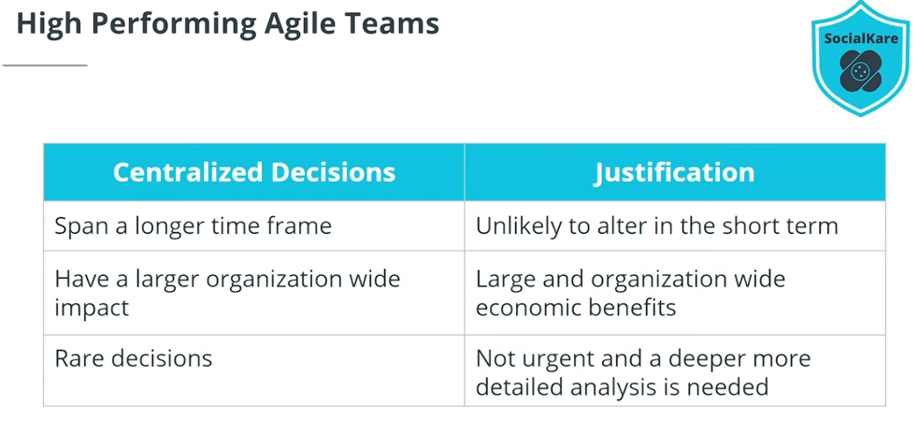

Slide 38
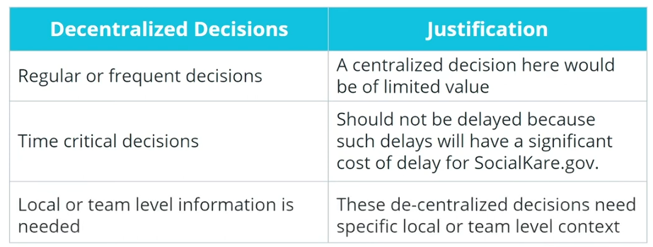

Slide 39
What Kills High-Performance Teams?
Pitfall #1: Conflicts are not managed effectively; it is important to regularly remind the Agile Team of the value of respectfully discussing differing opinions and suggestions.
Pitfall #2: Blame game begins; there needs to be a tolerance for some failures since Agile Teams work in fast-paced situations. Such blame games and negative criticism quickly escalate to unhealthy conflict. The smarter and healthier outlook is to continue to keep the Agile Team on a learning mindset.
Pitfall#3: Rules of Engagement are not followed; the Facilitator must ensure the Agile Team honors the agreed-upon rules of engagement and that team communications are frequent and relevant to avoid a high performing Agile Team from commencing its decline.
Pitfall #4: Spark or passion is dimmed; if the Agile Team starts to perceive that their work is not as valuable, it can annihilate motivation. When the product vision starts to get foggy, the Product Owner needs to quickly step in to clarify.

Slide 40
New Terms
Blame Game: Circumstances in an Agile team where team members try to blame each other for issues and challenges rather than working together to collaboratively resolve what they are encountering
Additional Resources
Governing Agile Teams: This blog post covers various abysmal Agile implementation mistakes.

Slide 41
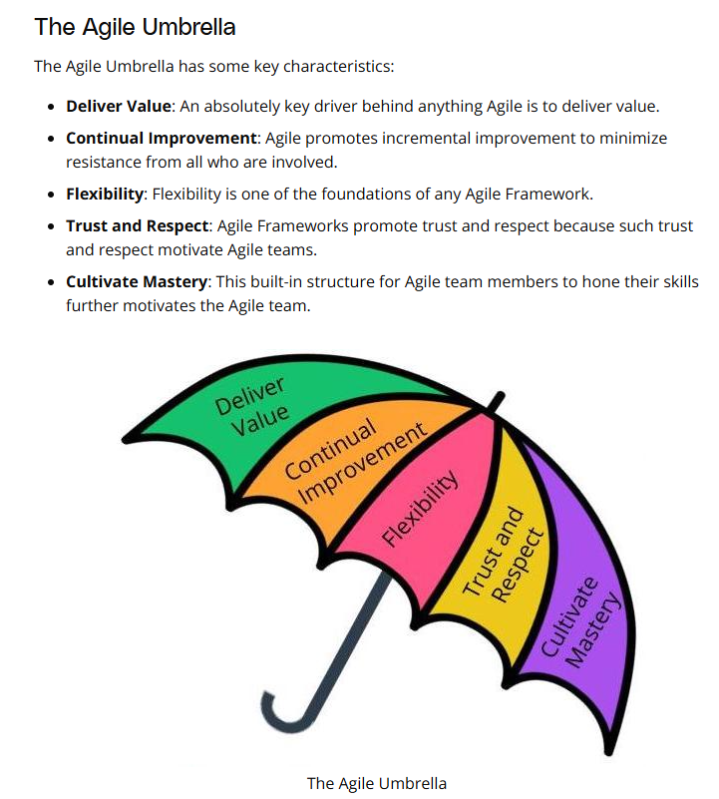

Slide 42
Scrum Framework
Scrum is by far the most common Agile Framework.
The features are delivered in iterations known as Sprints.
The Team conducts Daily Stand-Ups in which they provide updates to each other.
Retrospectives are conducted to identify opportunities for improvement at the end of each Sprint.
Specific roles, as well as certain Ceremonies, are recommended in the Scrum Framework.
Scrum Pillars
Transparency - Transparency builds trust and openness both within the Agile Team, as well as with those stakeholders outside the Agile Team.
Inspection - Inspection involves the business users reviewing the Agile Team’s progress towards the defined goals.
Adaptation - Agile Teams adjust and adapt based on opportunities for improvement that are identified either by the Agile Team themselves or through feedback from others outside the team.

Slide 43
5 Scrum Values
Focus - Everyone in the Team focuses on the work to be completed in order to deliver the Sprint goals.
Courage - Members of the Team need to have the courage to do what is right to ensure the Sprint goals are met.
Openness - The Team and its stakeholders agree to a culture of openness.
Commitment - Commitments build trust within the Agile Team members, as well as with the business users and leaders.
Respect - Respect is a key in Scrum for a high-achieving Agile Team.

Slide 44
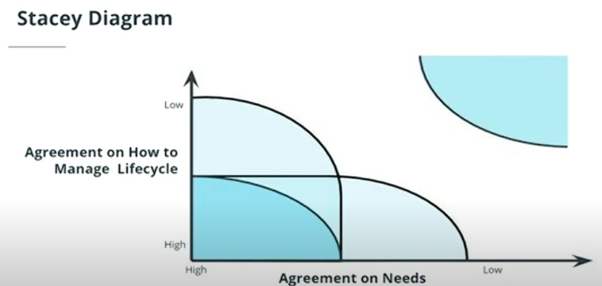
When Scrum Does Not Make Sense
As shown in the Stacey diagram, an Agile Framework like Scrum works best with complex and complicated projects and products. There may not be much value in utilizing Agile principles
when there is a near certainty in both the requirements and process upfront.
when there is chaos. Scrum cannot bring value to an environment where there is no vision or clear roadmap.
when the project is simple and predictable and the need for iterative learning and adapting is of no value.

Slide 45
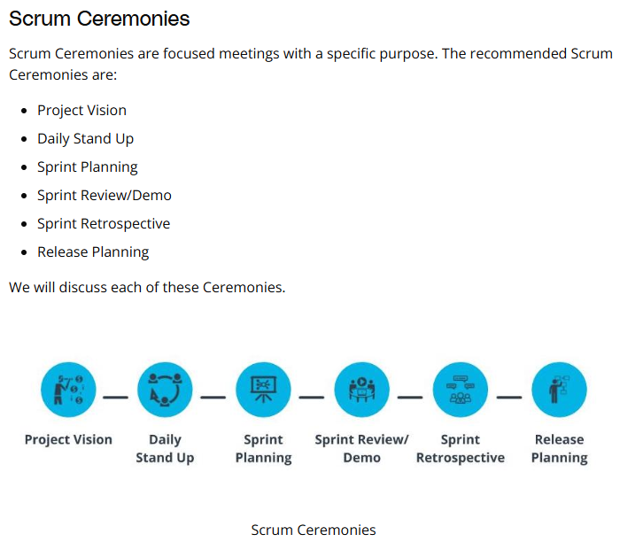

Slide 46
Project Vision, Daily Stand Up, and Sprint Planning
Project Vision
Project Vision Ceremony is where the business leaders identify the business need the project’s product deliverable is intended to achieve.
Agenda - Discuss the project goals, identify the sponsor, and outline the project vision, success criteria, assumptions, constraints, and risks.
Project Vision occurs once per project and is scheduled before the project launch.
Scrum recommends this ceremony be time-boxed to 1 hour.
Outcome - Business leaders create a desired future state statement.

Slide 47
Daily Stand Up or Scrum
The Daily Stand Up is used to synchronize activities and create a short-term plan for the next 24 hours.
It is time-boxed to 15 minutes and is held every day, throughout the whole scrum ceremonies, ideally at the same time daily.
Three questions are addressed by each Team member briefly:
What did I do since the last time we met?
What do I plan to accomplish today?
What impediments am I encountering?
This is a very valuable Ceremony in which all Team members get an opportunity to report issues they are facing; cultivates transparency across the product development journey.

Slide 48
Sprint Planning
The Team self-organizes and plans out the work to be performed in the Sprint.
The work is prioritized by the Product Owner.
Time-boxed to not more than eight hours for a one-month Sprint.
Agile Team works with the PO and Scrum Master to address the following three questions:
What are we committing to deliver in the upcoming Sprint?
How will we complete the work required to achieve this commitment?
What are the respective estimates for each user story and associated tasks?
The Agile Team takes the prioritized backlog items and collaborates on how to carry out the work.
Notes: the Daily Stand Up or Scrum is held daily, including the time between Sprint Planning and Sprint Review.

Slide 49
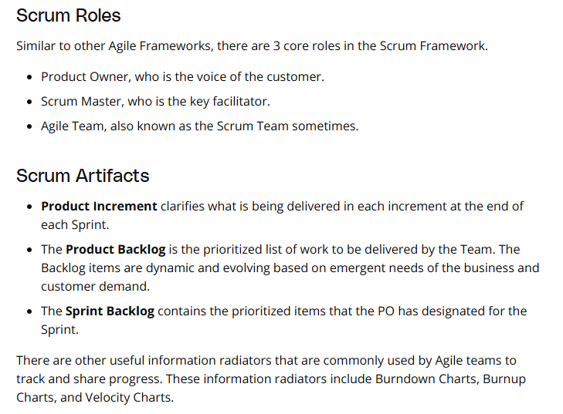
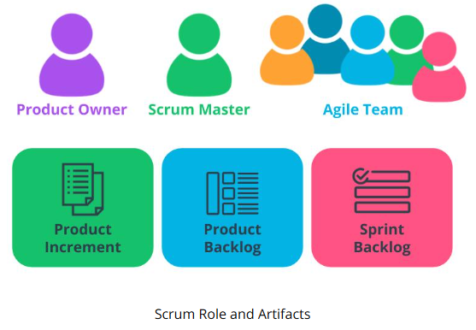
Scrum Roles and Artifacts

Slide 50
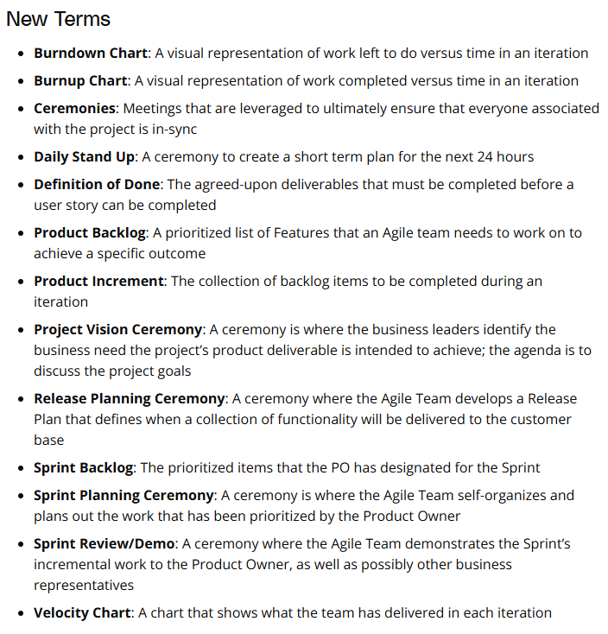

Slide 51
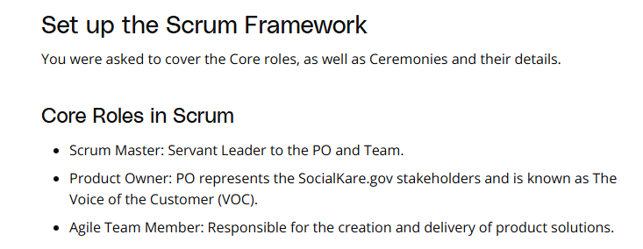

Slide 52
Scrum Ceremonies
Retrospective: An opportunity for the Team to inspect itself and create a plan for improvements; time-boxed to 3 hours once per Sprint.
Project Vision: Business leaders articulate the business need that is intended to be achieved; time-boxed to 1 hour and occurs once per project.
Release Planning: A Release Plan is defined as to when various sets of usable functionality or products will be delivered to the customer; time-boxed to 20 minutes per Release.
Sprint Planning: Work to be performed in the Sprint is planned; can occur a few times per Sprint; time-boxed to a total of 8 hours per Sprint.
Daily Stand-Ups: The team synchronizes activities and creates a plan for the next 24 hours; Each team member answers 3 questions: What did I do since the last time we met? What do I plan to accomplish today? What impediments am I encountering?; held daily (preferably in the morning); time-boxed to 15 minutes.
Sprint Review and Demo: Along with Demo, the Team discusses marketplace changes and backlog with PO; the Team presents completed Sprint deliverables to Product Owner; time-boxed to 4 hours once per Sprint.

Slide 53
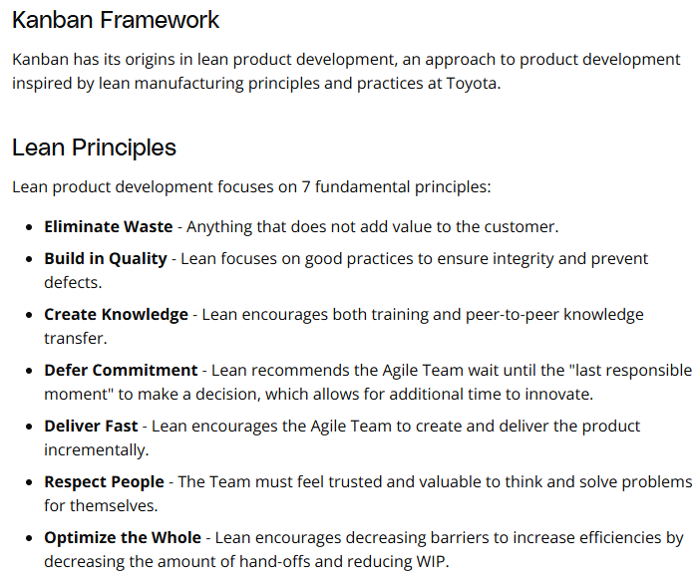
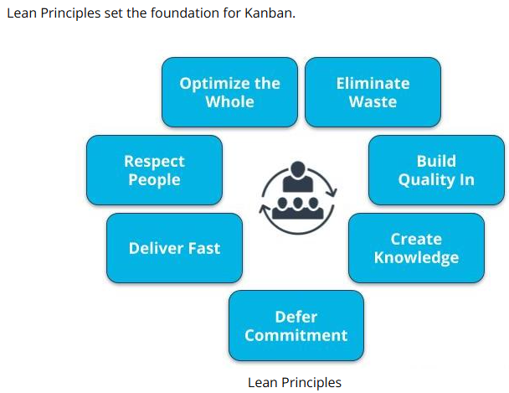

Slide 54
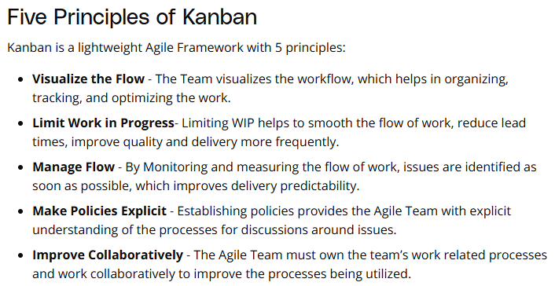
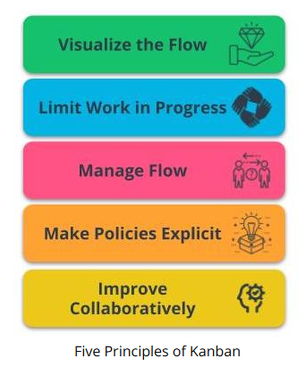

Slide 55
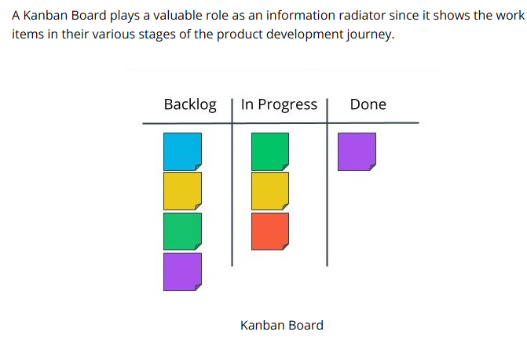

Slide 56
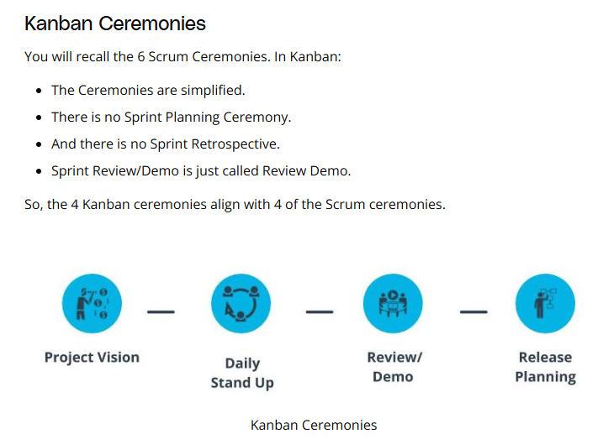

Slide 57
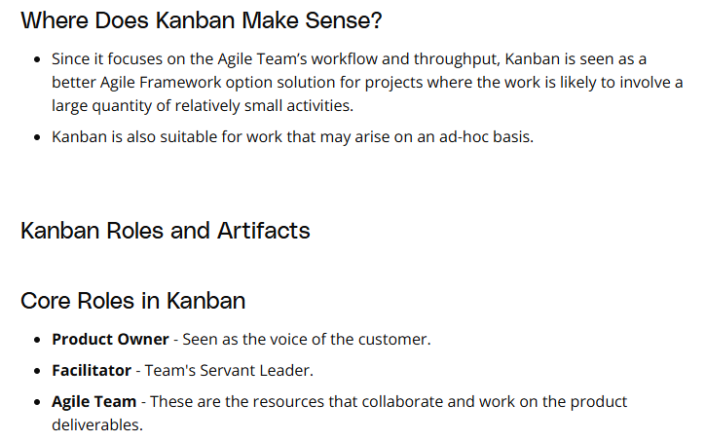

Slide 58
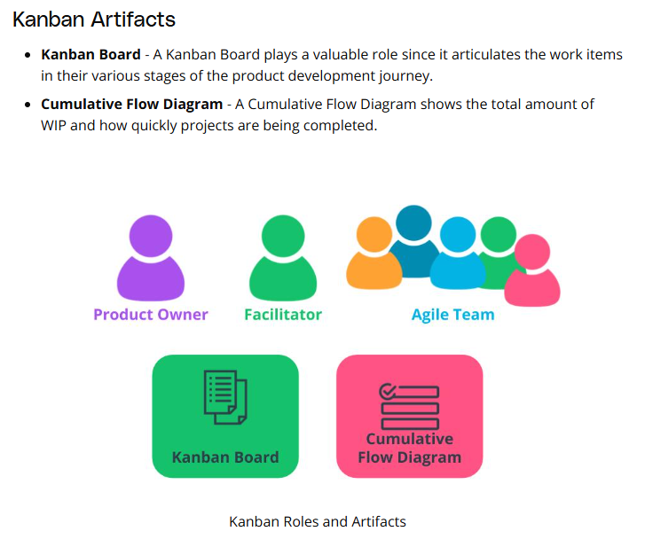

Slide 59
New Terms
Cumulative Flow Diagram: A diagram that shows the total amount of WIP and how quickly projects are being completed
Flow: How work items in a process move through the various stages of development
Kanban Board: A visual representation of the Agile team's work at various stages with a separate column for each stage
Kanban: A lightweight Agile Framework that has its roots in Lean Principles
Lean Development: A process to eliminate Muda by leveraging innovative solutions to reduce cycle time and cost
Additional Resources
Agile Alliance: Kanban(opens in a new tab): Additional details on the Kanban Framework.
Kanban at Blizzard Sport(opens in a new tab): Blizzard Sports' case study shows the value of Kanban and its lightweight yet effective approach to delivering value.

Slide 60
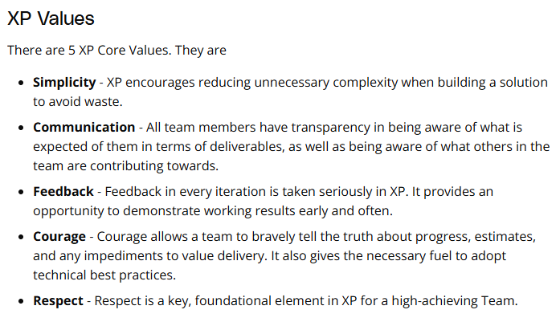
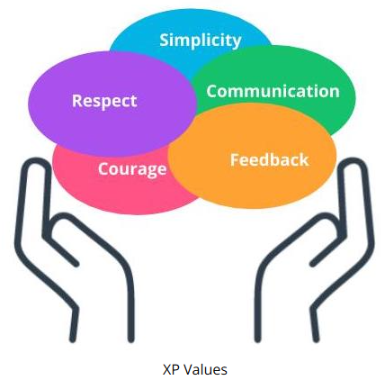
XP Values
Extreme Programming, also known as XP, is a powerful Agile Framework with its roots in software development. XP has a strong focus on technical excellence and best practices in software development.

Slide 61
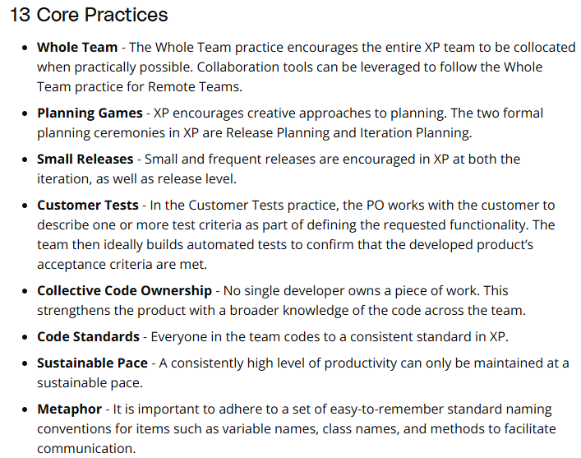
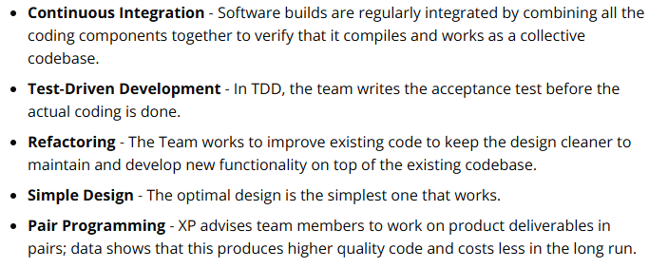
XP Practices
The 5 XP core values discussed earlier set the tone for XP’s 13 core practices.

Slide 62
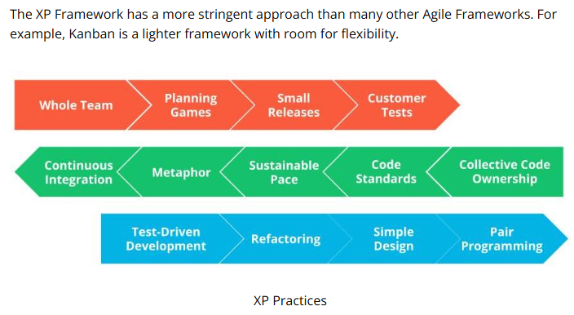

Slide 63
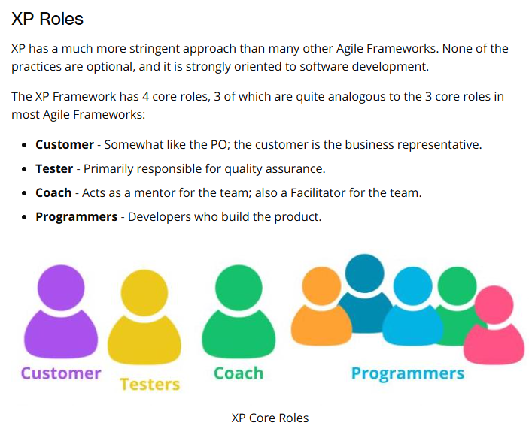
XP Core Role and Ceremonies

Slide 64
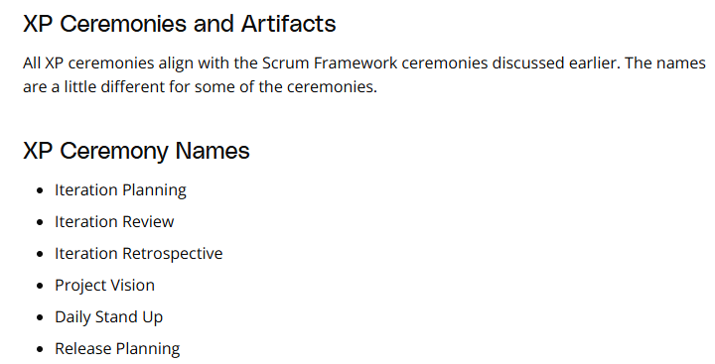

Slide 65
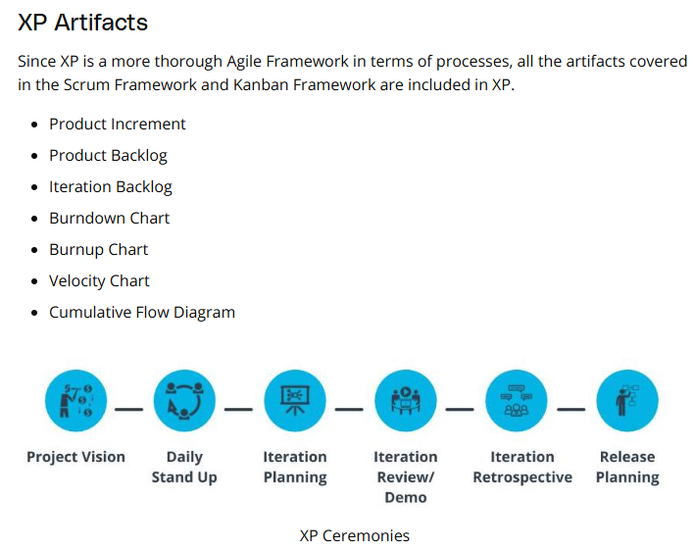

Slide 66


Slide 67
Additional Resources
Kent Beck. Extreme Programming Explained: Embrace Change, 2nd Edition. Pearson, 2004. This is the book where Kent Beck, introduces XP and its 13 Practices.
Exploring Extreme Programming in Context: An Industrial Case Study: This research paper published in the academic journal IEEE Computer Society, Layman, Williams and Cunningham discusses how XP was implemented at Sabre Airline Solutions.

Slide 68


Slide 69
XP Doesn't Work For Every Team
Challenges with XP
While many organizations get excited when they read that XP brings in rigor alongside the typical benefits of Agile, Agile teams often encounter challenges with XP:
XP is software-centric - XP places emphasis on software development practices, unlike many other Agile Frameworks in which the emphasis is more on streamlining processes.
XP Coaches are Tough to Recruit - Recruiting experienced XP coaches is a challenge. XP coaches are expected to be familiar with software development, as well as have the right personality and temperament to facilitate ceremonies and difficult conversations.
XP is Complex - XP is complex to implement and often feels anti-Agile to some organizations and their leaders. With 13 defined practices, XP has considerably more practices than many other Agile Frameworks.
Organizations who are thinking of XP need experienced XP Coaches, a willing and highly skilled team of programmers, and leaders who have the resilience to guide the organization through the initial transformation.
Additional Resources
Kanban vs Scrum vs XP – an Agile comparison(opens in a new tab): Jim Bowes walks through the differences between Scrum, XP and Kanban, which includes some of the challenges of XP.

Slide 70


Slide 71


Slide 72



Slide 73
1st project
WorldVisitz Agile Transformation
In this project, you will apply the Agile skills you will have acquired in this course to step into a business case as an Agile consultant to help WorldVisitz launch its agile journey.
Your job is to define an Agile delivery solution to transform their current traditional product development processes. You will create two presentations, one for WorldVisitz executives, and the other for the WorldVisitz team.
The presentation for executives (you can make a copy of this "Agile Framework" project template on Google Slides or download the ppt template from the Resource section):
How WorldVisitz Can Benefit From Agile
The Optimal Agile Framework for WorldVisitz
The team presentation's goal is to get the WorldVistz team members ready for their Agile journey. The presentation should:
Onboard the Team (you can make a copy of this "Agile Onboarding" project template on Google Slides or download the ppt template from the Resource section):
Explain Agile benefits
Set the team up for success

Slide 74



Slide 75


Slide 76


Slide 77


Slide 78


Slide 79


Slide 80


